Slide 1
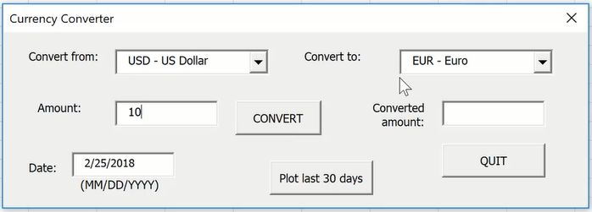
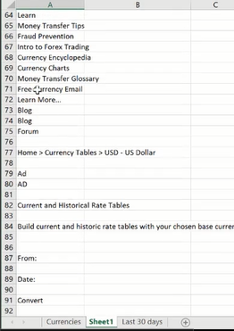
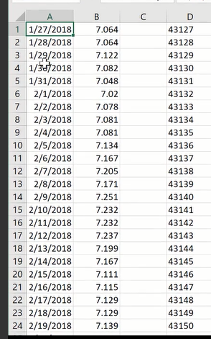
Week 2 – 1 Currency Converter
1) When the Convert button is pressed, it will go to the website and find the rate based on the date (default is today’s date) and outputs the converted amount.
2) The last 30 days button finds data based on the date entered and plots the last 30 days value
Sheet 1 is where the data from website is stored
When you run the Sub, it will unhide Sheet1, import the data,
do the conversion and finally hide sheet1 again
Sheet 2 is where the last 30 days for a currency is stored
Need to hide it at the end

Slide 2
